Slide 1
Bike/Ped Safety and Mobility in Arkansas:
Ben Whatley, E.I.
Advanced Traffic Safety Engineer
Transportation Planning & Policy
Stepping Toward a Safer Place for Non-Motorists

Slide 2
Non-Motorist Crash Trends
Bike/Ped Crash Trends
Bike/Ped Mobility Trends
Current ARDOT Efforts
Next Steps

Slide 3
Non-motorists
Someone who is traveling without the aid of a motor vehicle
Pedestrians
Bicyclists
Wheelchair users
Scooter Riders
Riding an animal/animal drawn buggy
Others
Notes:
Start out with a definition.
Non-Motorist = Someone who is traveling without the aid of a motor vehicle

Slide 4
Notes:
Downtrend in NM Fatalities 1994-2009
Sharp fatality uptick in 2009 & 2014
***Smartphones becoming ubiquitous around 2013, 2014
Overall, downward trend until 2009, and then major spike upwards.

Slide 5
Notes:
Arkansas though, not as clearly defined. Kind of looks like roller coaster
Last 10 years been oscillating between about 40 and 55 NM fatalities.

Slide 6
Notes:
Combined fatal and serious injury crashes
Alarming trend

Slide 7
Notes:
Urban fatal non motorist crashes going up
Rural fatal non motorist crashes remaining flat

Slide 8
Notes:
Big increase (doubled) in urban serious injury crashes

Slide 9
Notes:
Continuing to dig deeper into the data—data field called (Type of non motorist)
(KA) = fatal and serious injury
Highest by far is “Pedestrians”
Next Highest is “Bicycles”

Slide 10
Notes:
Highest—”Travel Lane-Other Location”---vague
“Intersection Marked Crosswalk”—Went up in 2017.
Apart from that…Not another category that comes close

Slide 11
Notes:
Highest—”Crossing roadway”
Next Highest—”In Roadway-Other”

Slide 12
Notes:
Top line (blue)—”No Improper Action”
Next highest (teal)—”In Roadway Improperly”
Next Highest (dark red)—”Darted or Dashed”
Next highest (pink)—”unknown”
Next Highest (dark green)—”Failed to Yield ROW”
THE POINT = “No Improper Action” was top category, but also some improper action by non-motorists

Slide 13
Summary
Increasing trends:
Urban
Fatalities & Serious Injuries
Pedestrians Crossing Roadways
Notes:
Increases in Non Motorist KA crashes seem to be coming from:
**Urban areas
**Fatalities and & Serious Injuries
**Pedestrians crossing roadways

Slide 14
Another Factor…
2015-Electronic Crash Reporting Upgrade
Reports automatically reported to State Police
Mostly State Police in 2015
2016-Present
Growing number of agencies electronically reporting
Growing number of crash reports in the database
Notes:
2015—ASP switch to eCrash

Slide 15
Notes:
Prior to 2015, about 60,000 crashes per year in crash database.
Crashes in database
2015 = 68,000
2016 = 75,000
2017 = 79,000
Agencies
2015 = 15
2016 = 84
2017 = 133
2018 = 178

Slide 16
Notes:
I showed this graph earlier----compare to number of crashes in database
As number of Crashes in database go up, as number of agencies on eCrash go up, NM KA Crashes go up

Slide 17
Things to Consider…
National increase in non-motorist fatalities
Distracted driving
Smartphones have become ubiquitous
Are more people walking/biking?
More non-motorist infrastructure
Regional trail systems
More bike lanes
More locally adopted bike/ped plans
Notes:
**National Increase in NM Crashes
**Distracted Driving
**Are more people walking/biking? (Couldn’t quantify…but qualitative things we can see)
****More NM infrastructure
*******Regional Trails Systems (AR River Trail, Razorback Greenway)
*******More bike lanes
*******More locally adopted bike/ped plans

Slide 18
Crash Data Takeaway
Increase likely due to multiple factors
Original numbers were under-reported
Distracted Driving
More non-motorist infrastructure/activity
Notes:
Original number likely underreported
**We know there were some local jurisdictions that were not submitting crash reports
We know there has been an increase in Distracted Driving
We also know that there has been a growing interest in bike/ped facilities and facilities planning.

Slide 19
Growing Interest in Bike/Ped Activity
Shift in non-motorist issues
Issue use to be pedestrians crossing freeways
Shifting to pedestrian accessibility
More people walking/biking for:
Work
Education
Healthcare
Recreation
Other reasons
Notes:
Work
*** I have a friend who used to live in Riverdale, and would bike to work in Riverdale.
Education
*** University of Arkansas/City of Fayetteville has a bike share program
Healthcare
*** Riding bike is exercise
Recreation
*** Multi-use trails becoming very popular.
Other
*** Perhaps philosophical reasons
***Can’t afford vehicle

Slide 20
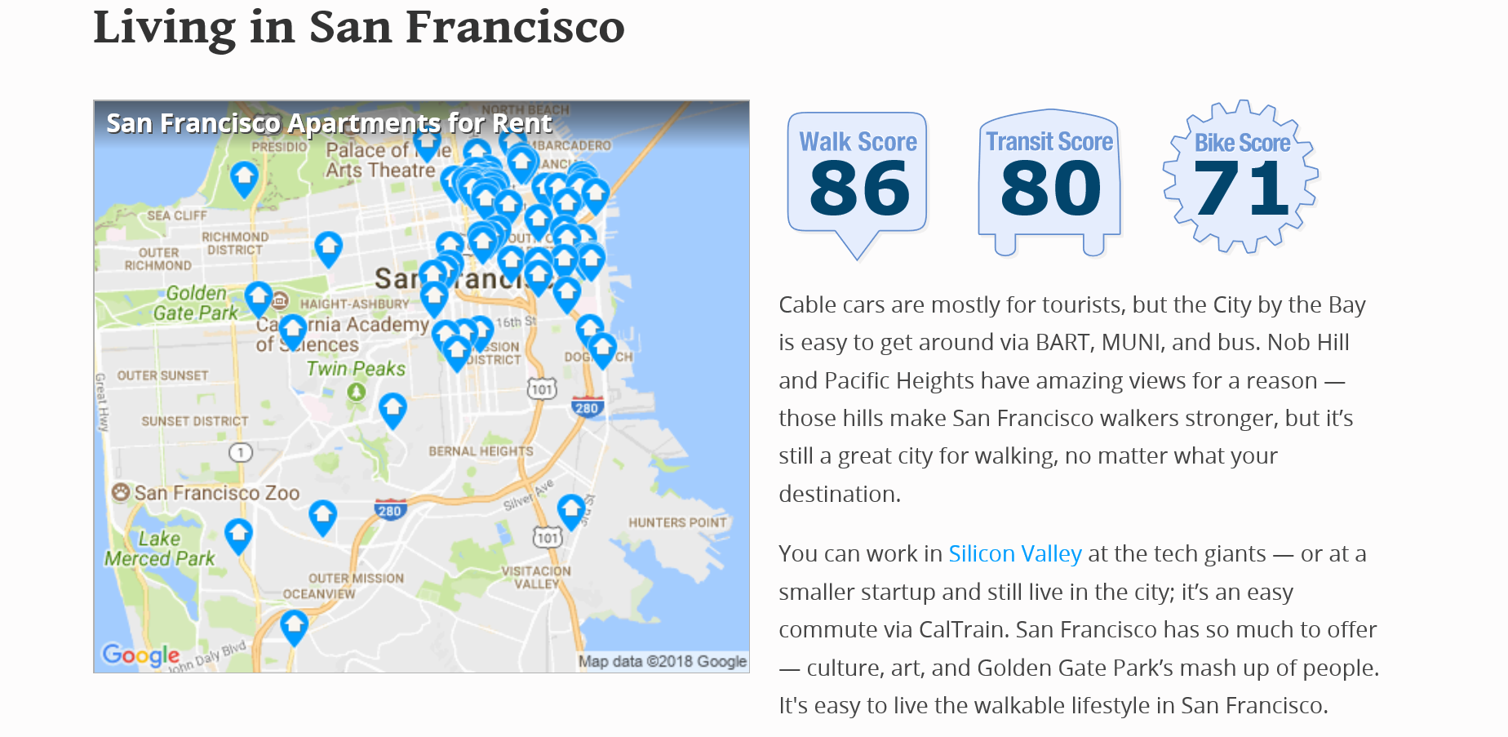
Growing Interest in Bike/Ped Activity
Non-motorist scoring (Walkscore.com)
Walk scores
Bike scores
Transit scores

Slide 21
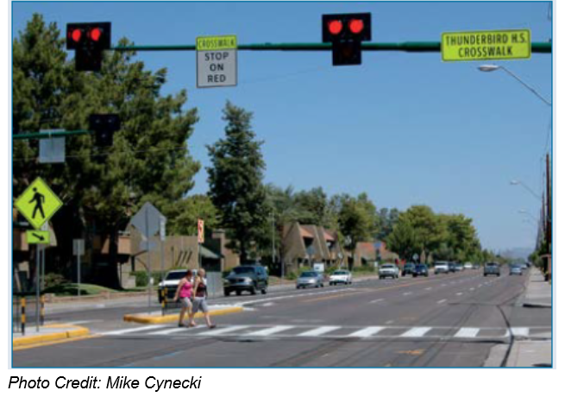
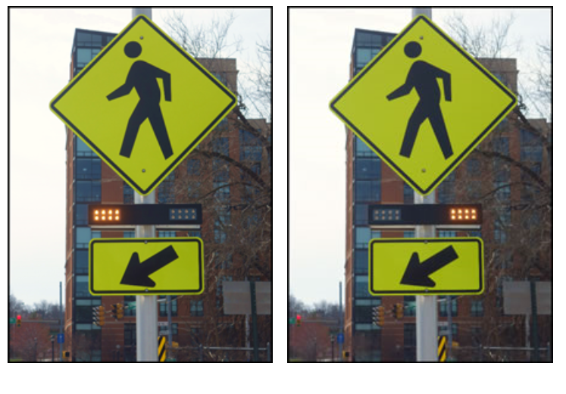
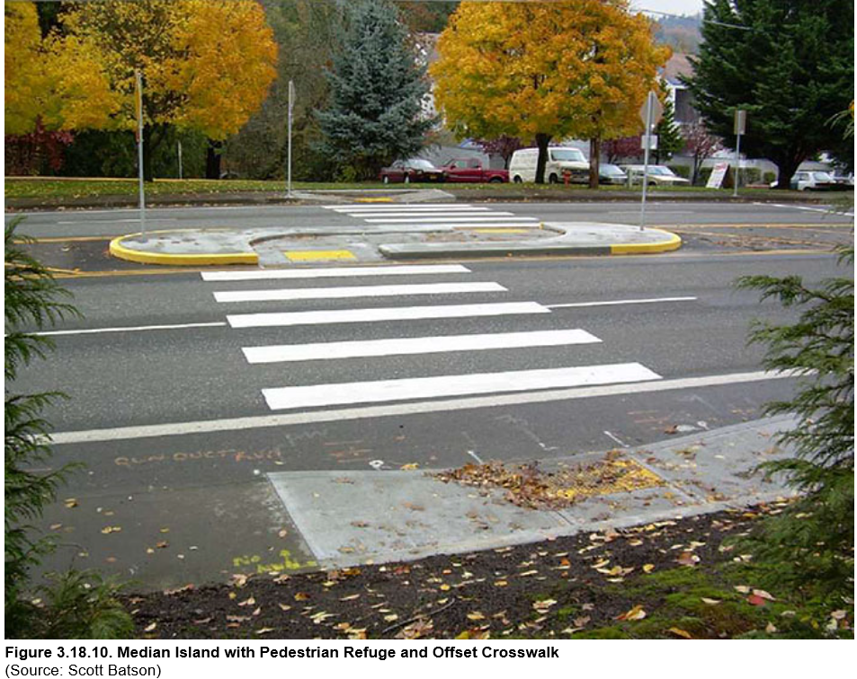
Growing Interest in Bike/Ped Safety
FHWA STEP (Safe Transportation for Every Pedestrian) Initiative
Promotes pedestrian crash countermeasures with known benefits
Notes:
RRFB—Rectangular Rapid Flashing Beacons
PHB—Pedestrian Hybrid Beacon
Refuge Island

Slide 22
Current ARDOT Efforts
Bicycle Facility Accommodation and Sidewalk Policy Update Committee
FHWA – Arkansas Division
Maintenance Division
Program Management Division
Roadway Design Division
System Information and Research Division
Transportation Planning and Policy Division
Resources
AASHTO Green Book
AASHTO Guide for the Development of Bicycle Facilities
Manual on Uniform Traffic Control Devices
Notes:
Established as part of the implementation of the 2017 Arkansas Bicycle and Pedestrian Transportation Plan.
Update Bicycle and Pedestrian Accommodation Plan: Objectives include:
better definition of the coordination/accommodation process
- design
- funding
- construction
- maintenance
overall improvement of communications with non-motorized users
investment of local jurisdictions in the process (local plan approval, local financial commitment)

Slide 23
Current ARDOT Efforts
Safety Performance Management
Non-Motorist Fatal and Serious Injuries
“FHWA establishes in this final rule an additional safety performance measure: the number of combined non-motorized fatalities and non-motorized serious injuries in a State.”
23 CFR 490
2018 is first year to measure performance against target.
Notes:
Transportation Performance management is a big buzz word these days in Transportation Industry
***Safety Performance Management is subset of that
5 Safety Performance measures:
**Fatalities, Fatality rate
**Serious Injuries, Serious injury rate
**Non-Motorist Fatalities and serious injuries
**Have to set Targets
**Have to report to FHWA every year if we meet out targets
**2018 is the first year to see if we met performance targets

Slide 24
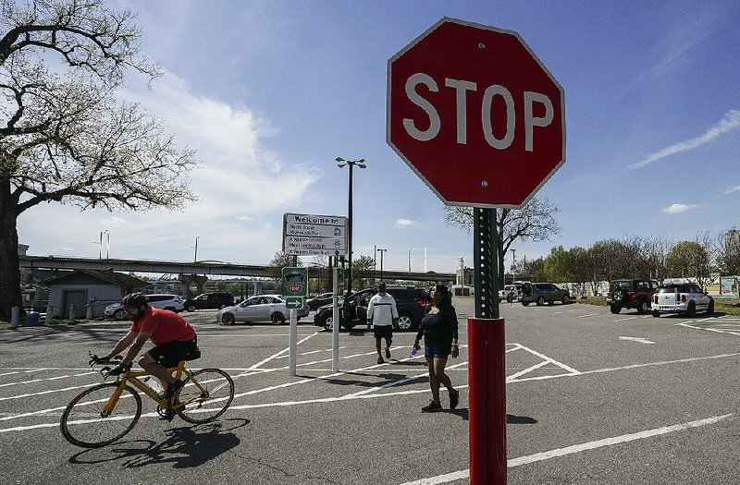
Next Steps
Continued Public Education
US Bike Route Numbering Efforts
Hub Communities
Act 650 of 2019 Arkansas General Assembly
Notes:
Continued Public Education
**City of LR beta tested a bicycle awareness program.
US Bike Route Numbering Efforts
***UAMS contracting w/ consultant
***Effort to create a bike route b/w LR and Memphis.
***Windshield surveys of 2 corridors
Hub Communities
***Communities willing to provide food, lodging, bicycle shops, other services for cyclists
***These are hubs would be part of the US Bike Route
Act 650 of 2019
**Allows bikes to yield at STOP sign/treat traffic signals as a stop sign
**can help prevent vehicle queueing as bicycle approaches STOP sign

Slide 25
Safety, Accessibility, and Mobility are everyone’s job
Notes:
Safety, Accessibility, and Mobility are everyone’s job
Local jurisdictions
Other agencies
ARDOT
Local Jurisdictions – Adopt Local bike/ped plans
Other agencies:
UAMS
State Department of Health
State Parks and Tourism
Governor's Advisory Council on Cycling
Arkansas Economic Development Commission
All of these are working to help us implement the Bike-Ped Plan

Slide 26
Questions?

